Slide 1
V SEMESTER
COMPUTER NETWORKS
21CST502
Dr. PRERANA CHAITHRA

Slide 2
UNIT 1
INTRODUCTION TO NETWORKS
Computer Networks 21CS502 Module 1
Dr. PRERANA CHAITHRA

Slide 3
UNIT 1
CHAPTER 1
INTRODUCTION
Computer Networks 21CS502 Module 1
Dr. PRERANA CHAITHRA

Slide 4
Introduction
When we communicate, we share information
Information sharing can be
  Local Communication
Communication between individuals occur face to face
  Remote Communication
Communication between individuals occur over distance
Telecommunication
  Communication at a distance
  In Greek Tele means Far
  Example Telephony, Telegraphy, Television
Dr. A.I.T., C.S.E. Dr. Prerana Chaithra Computer Networks 21CST502 Module 1

Slide 5
1.1 Data Communications
Data :
Data refers to the information presented in whatever form
is agreed upon by the parties creating and using data.
Data Communications :
Exchange of data between two devices via some form of transmission medium such as a wire cable.
For Data communication to occur, the communicating devices must be a part of a Communication System.
Communication System consists of
  Hardware – Physical equipment
  Software - Programs
Dr. A.I.T., C.S.E. Dr. Prerana Chaithra Computer Networks 21CST502 Module 1

Slide 6
Fundamental Characteristics of Data Communications
Delivery :
The system must deliver data to the Correct Destination
Accuracy :
The system must deliver the Data accurately.
Timeliness :
The system must deliver data in a Timely manner.
Real Time Transmission – for audio & videos
Jitter :
It is the variation in the packet arrival time.
Dr. A.I.T., C.S.E. Dr. Prerana Chaithra Computer Networks 21CST502 Module 1

Slide 7
Components of Data Communications System
Message :
It is the information to be communicated.
Text, numbers, pictures, audio, video
Sender :
It is the device that sends data message.
Computers, telephone handset, video camera
Transmission medium :
It is the physical path by which a message travels from sender to receiver
Twisted pair wire, coaxial cable, fiber optics cable, radio waves
Dr. A.I.T., C.S.E. Dr. Prerana Chaithra Computer Networks 21CST502 Module 1

Slide 8
Components of Data Communications System
Contd..
Receiver :
It is the device that receives the data message.
Computers, telephone handset, television, workstation
Protocol :
It is a set of rules that govern data communications.
It represents the agreement between the communicating devices.
Without a protocol, two devices may be connected but not communicating.
Dr. A.I.T., C.S.E. Dr. Prerana Chaithra Computer Networks 21CST502 Module 1

Slide 9
Components of Data Communications System
Contd..
Protocol Protocol
Rule 1
Rule 2
Rule 3
.
.
.Rule n
Rule 1
Rule 2
Rule 3
.
.
.Rule n
Messge
Sender
Receiver
Transmission Medium
Dr. A.I.T., C.S.E. Dr. Prerana Chaithra Computer Networks 21CST502 Module 1

Slide 10
Data Representation
Text :
Bit pattern
Code
Unicode – 32 bits - any language
ASCII American Standard Code for Information Interchange
Numbers :
Bit patterns
ASCII is not used
Decimal - Base 10
Binary – Base 2
Hexadecimal – Base 16
Dr. A.I.T., C.S.E. Dr. Prerana Chaithra Computer Networks 21CST502 Module 1

Slide 11
Data Representation
Images :
Bit patterns
Matrix of pixels ( picture elements )
Black and White image
  0 – Black
  1 - White
Grey Scale image
  00 Pure black
  01 Dark Grey
  10 Light Grey
  11 Pure white
Color image
  RGB method – Red, Green, Blue
  YCM Method – Yellow, Cyan, Magenta
Audio
Video
Dr. A.I.T., C.S.E. Dr. Prerana Chaithra Computer Networks 21CST502 Module 1

Slide 12
1. DATA COMMUNICATIONS
2. NETWORKS
AGENDA
Computer Networks 21CS502 Unit 1
Dr. PRERANA CHAITHRA

Slide 13
Data Flow
Communication (Data flow) between two devices can be
Simplex
Half-duplex
Full-duplex
Dr. A.I.T., C.S.E. Dr. Prerana Chaithra Computer Networks 21CST502 Module 1

Slide 14
Simplex Communication (Data flow)
Communication : Unidirectional
Transmission : Only one device on a link can transmit and the other device can only receive.
Channel capacity : used to send data in one direction
Example : Keyboard, Traditional monitor
Mainframe
Direction of Data
Monitor
Dr. A.I.T., C.S.E. Dr. Prerana Chaithra Computer Networks 21CST502 Module 1

Slide 15
Half-Duplex Communication (Data flow)
Communication : Each station can both transmit and receive, but not at the same time.
Transmission : When one device is sending the other device can only receive and vice versa.
Channel capacity : Entire capacity of the channel is taken over by the device which is transmitting at that time.
Example : Walkie–Talkies, CB (Citizen Band) radios
Station
Direction of Data at time 1
Station
Direction of Data at time 2
Dr. A.I.T., C.S.E. Dr. Prerana Chaithra Computer Networks 21CST502 Module 1

Slide 16
Full-Duplex Communication (Data flow) or Duplex
Communication : Bi-directional
Transmission : Both stations can transmit and receive, simultaneously
Channel capacity : Entire capacity of the channel is divided between the two devices. The sharing can occur in 2 ways:
  The link must contain 2 physically separate transmission paths. One for sending and other for receiving.
  The capacity of the channel is divided between signals travelling in both directions.
Example : Telephone network
Station
Direction of Data at all time
Station
Dr. A.I.T., C.S.E. Dr. Prerana Chaithra Computer Networks 21CST502 Module 1

Slide 17
1.2 Networks
Network is the interconnection of a set of devices capable of communication.
A Device can be
  Host ( or End System)
  Connecting device
Host - Example: Large computer, Desktop, laptop, workstation, cellular phone, security system, etc.
Connecting device
  Router : Connects the network to other networks
  Switch : Connects devices together
  Modem : Changes the form of data
Dr. A.I.T., C.S.E. Dr. Prerana Chaithra Computer Networks 21CST502 Module 1

Slide 18
Networks
Transmission media used for connecting the devices in a network are
  Wired : Example Cable
  Wireless : Example Air
In Distributed Processing a task is divided among multiple computers.
  Most networks use distributed processing instead of one single large machine being responsible
Dr. A.I.T., C.S.E. Dr. Prerana Chaithra Computer Networks 21CST502 Unit 1

Slide 19
Network Criteria
A network must meet a certain criteria such as
  Performance :
  refers to the measures of service quality of a network as perceived
  by the user
  Reliability :
  refers to the working of the network without disruption for a
  specified period of time
  Security :
refers to protecting the usability and integrity of the
network and data.
Dr. A.I.T., C.S.E. Dr. Prerana Chaithra Computer Networks 21CST502 Unit 1

Slide 20
Network Criteria - Performance
Networking metrics used to evaluate Performance
    Throughput :
  is the amount of data that can be transmitted through a network within a given period of time.
  Delay :
  is the amount of time required for one packet to go from its source to a destination.
  Performance increases if throughput is more and delay is less.
Performance can be measured based on
  Transit Time :
  is the amount of time required for a message to travel from one device to another
  Response Time :
  is the elapsed time between an inquiry and response
Dr. A.I.T., C.S.E. Dr. Prerana Chaithra Computer Networks 21CST502 Unit 1

Slide 21
Network Criteria – Performance (Contd..)
Performance of a network depends on
  Number of users
  Type of transmission medium
  Capabilities of the connected hardware
  Efficiency of the software
Dr. A.I.T., C.S.E. Dr. Prerana Chaithra Computer Networks 21CST502 Module 1

Slide 22
Network Criteria - Reliability
Network reliability is measured by
  Frequency of failure
  Time it takes to link to recover from a failure
  Network’s robustness in a Catastrophe
Dr. A.I.T., C.S.E. Dr. Prerana Chaithra Computer Networks 21CST502 Unit 1

Slide 23
Network Criteria - Security
Network security issues include
  Protecting data from unauthorized access
  Protecting data from damage & development
  Implementing policies & procedures for recovery from breaches & data losses
Dr. A.I.T., C.S.E. Dr. Prerana Chaithra Computer Networks 21CST502 Unit 1

Slide 24
Physical Structures
Network attributes are
  Types of connection
  Point-to-Point connection
  Multipoint connection ( Multidrop connection)
  Physical Topology
  Mesh topology
  Star topology
  Bus topology
  Ring Topology
  Network Models
  LAN – Local Area Network
  WAN –Wide Area Network
  MAN – Metropolitan Area Network
Dr. A.I.T., C.S.E. Dr. Prerana Chaithra Computer Networks 21CST502 Unit 1

Slide 25
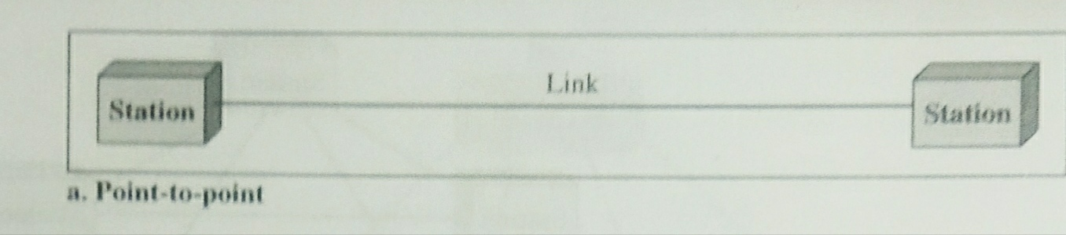
Types of Connection –
Point-to-Point connection
  Provides dedicated link between 2 devices
  Entire capacity of the link is for transmission between these 2 devices
  Connections use
    Actual length of wire or cable to connect the 2 ends
    Microwave or satellite links
    Example : connection between Television’s control system and
    infrared remote control
Dr. A.I.T., C.S.E. Dr. Prerana Chaithra Computer Networks 21CST502 Unit 1

Slide 26
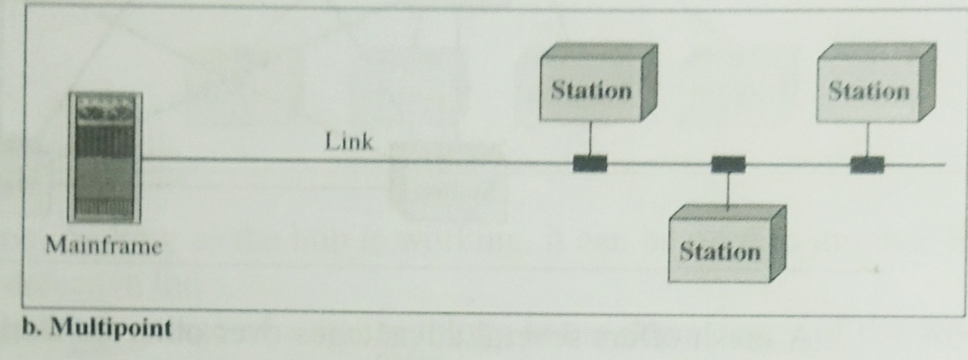
Types of Connection –
Multipoint connection ( Multidrop connection)
  More than 2 specific devices share a single link
  The capacity of the channel is shared in one of the ways
    Spatially
    Temporally
    Spatially : Several devices can use the link simultaneously
    Temporally : Users (devices) must take turns to use the link
    Example : Radio and Television broadcasting
Dr. A.I.T., C.S.E. Dr. Prerana Chaithra Computer Networks 21CST502 Unit 1

Slide 27
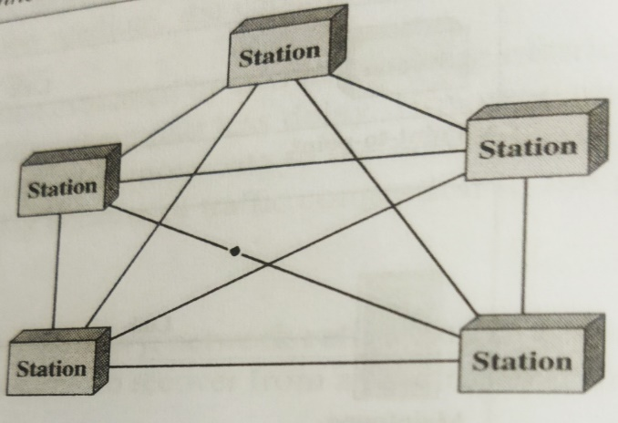
Physical Topology –
Mesh Topology
  A mesh topology is a type of computer network in which each node (computer or other device) is connected to every other node in the network.
Used in large organizations or companies because it can handle a large amount of data traffic and can be easily expanded.
All the devices are connected to each other .
There exists a dedicated point-to-point link between all devices.
There are n(n-1) physical channels to link n devices.
Every device not only sends its own data but also relays data from other nodes.
For ‘n’ nodes,
  there are n(n-1) physical-links
  there are n(n-1)/2 duplex-mode links
Every device must have (n–1) I/O ports to be
connected to the other (n-1) devices.
Dr. A.I.T., C.S.E. Dr. Prerana Chaithra Computer Networks 21CST502 Unit 1

Slide 28
Physical Topology –
Mesh Topology (Contd..)
Advantages:
  Congestion reduced: Each connection can carry its own data load.
  Robustness: If one link fails, it does not affect the entire system.
  Security: When a data travels on a dedicated-line, only intended-receiver can see the data.
  Easy fault identification & fault isolation: Traffic can be re-routed to avoid problematic links.
Disadvantages:
  Difficult installation and reconfiguration.
  Bulk of wiring occupies more space than available space.
  Very expensive: as there are many redundant connections.
  Not mostly used in computer networks. It is commonly used in wireless networks.
  High redundancy of the network-connections.
Dr. A.I.T., C.S.E. Dr. Prerana Chaithra Computer Networks 21CST502 Unit 1

Slide 29
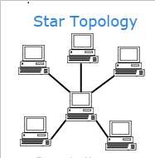
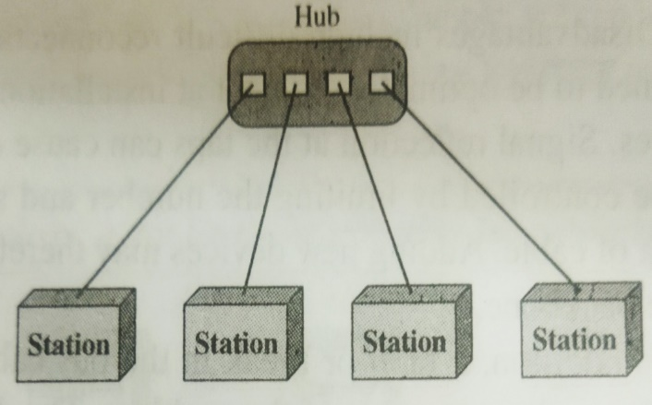
Physical Topology –
Star Topology
  Every node connects to a central network device in this configuration, like a hub, switch, or computer.
  The central network device acts as a server, and the peripheral devices act as clients.
  Entire capacity of the link is for transmission between these 2 devices
There exists a dedicated point-to-point link between a device & a hub.
The devices are not directly linked to one another. Thus, there is no direct traffic between devices. The hub acts as a junction:
If device-1 wants to send data to device-2, the device-1 sends the data to the hub, then the hub relays the data to the device-2.
Dr. A.I.T., C.S.E. Dr. Prerana Chaithra Computer Networks 21CST502 Unit 1

Slide 30
Physical Topology –
Star Topology (Contd..)
Advantages:
  Less expensive: Each device needs only one link & one I/O port to connect it to any devices.
  Easy installation & reconfiguration: Nodes can be added/removed without affecting the network.
  Robustness: If one link fails, it does not affect the entire system.
  Easy to detect and troubleshoot fault.
  Centralized management: The hub manages and controls the whole network.
Disadvantages:
  Single point of failure: If the hub goes down, the whole network is dead.
  Cable length required is the more compared to bus/ring topologies.
  Number of nodes in network depends on capacity of hub.
Dr. A.I.T., C.S.E. Dr. Prerana Chaithra Computer Networks 21CST502 Unit 1

Slide 31
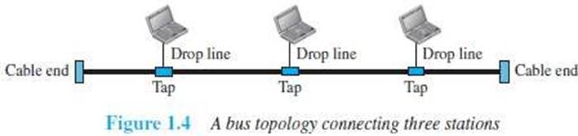
Physical Topology –
Bus Topology
  Bus topology is a type of network topology in which all devices are connected to a single cable called a "bus."
  This cable serves as a shared communication medium, allowing all devices on the network to receive the same signal simultaneously.
Every device communicates with the other device through this bus.
A data from the source is broadcasted to all devices connected to the bus.
Only the intended-receiver, whose physical-address matches, accepts the data.
Devices are connected to the bus by drop-lines and taps.
A drop-line is a connection running between the device and the bus.
A tap is a connector that links to the bus
Dr. A.I.T., C.S.E. Dr. Prerana Chaithra Computer Networks 21CST502 Unit 1

Slide 32
Physical Topology –
Bus Topology (Contd..)
  Advantages:
  Easy installation.
  Cable required is the least compared to mesh/star topologies.
  Redundancy is eliminated.
  Costs less (Compared to mesh/star topologies).
  Mostly used in small networks. Good for LAN.
  Disadvantages:
  Difficult to detect and troubleshoot fault.
  Signal reflection at the taps can cause degradation in quality.
  A fault/break in the cable stops all transmission.
  There is a limit on
  Cable length
  Number of nodes that can be connected.
  Security is very low because all the devices receive the data sent from the source.
Dr. A.I.T., C.S.E. Dr. Prerana Chaithra Computer Networks 21CST502 Unit 1

Slide 33
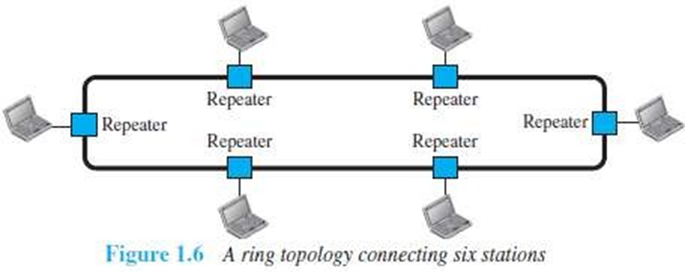
Physical Topology –
Ring Topology
  Ring topology is a type of network configuration where devices are connected in a circular manner, forming a closed loop.
  Each device is connected to exactly two other devices, creating a continuous pathway for data transmission.
Each device is connected to the next, forming a ring.
There are only two neighbors for each device.
Data travels around the network in one direction till the destination is reached.
Sending and receiving of data takes place by the help of token.
Each device has a repeater.
A repeater
  receives a signal on transmission-medium
  regenerates & passes the signal to next device.
Dr. A.I.T., C.S.E. Dr. Prerana Chaithra Computer Networks 21CST502 Unit 1

Slide 34
Physical Topology –
Ring Topology (Contd..)
Advantages :
  Easy installation and reconfiguration.
      To add/delete a device, requires changing only 2 connections.
  Fault isolation is simplified.
      If one device does not receive a signal within a specified period, it can issue an alarm. The alarm alerts the network-operator to the problem and its location.
  Congestion is reduced because all the traffic flows in only one direction.
Disadvantages :
Unidirectional traffic.
A fault in the ring/device stops all transmission.
The above 2 drawbacks can be overcome by using dual ring.
1. There is a limit on
  i) Cable length
  ii) Number of nodes that can be connected.
2. Slower: Each data must pass through all the devices between source and destination.
Dr. A.I.T., C.S.E. Dr. Prerana Chaithra Computer Networks 21CST502 Unit 1

Slide 35
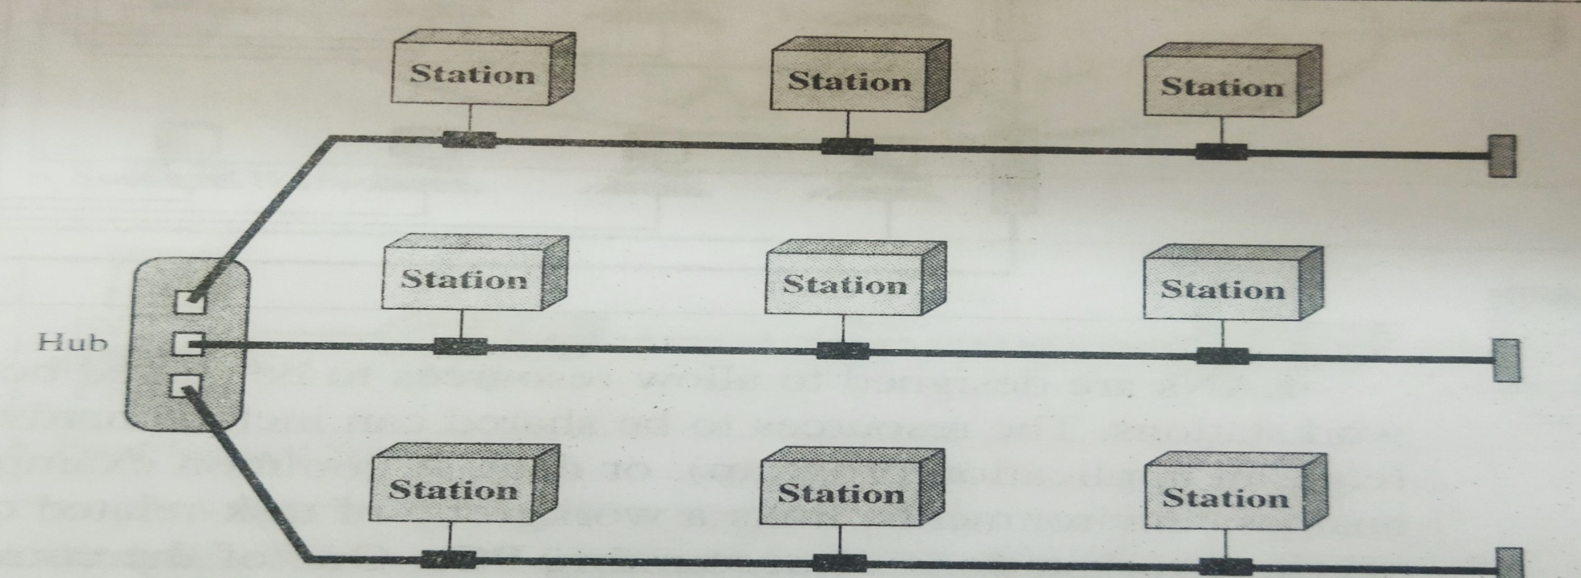
Physical Topology –
Hybrid Topology
  Hybrid topology is an interconnection of two or more basic network topologies, each of which contains its own nodes.
  The resulting interconnection allows the nodes in a given basic topology to communicate with other nodes in the same basic topology as well as those in other basic topologies within the hybrid topology.
Dr. A.I.T., C.S.E. Dr. Prerana Chaithra Computer Networks 21CST502 Unit 1

Slide 36
Network Models –
LAN – Local Area Network
  A local area network (LAN) is a computer network that interconnects computers within a limited area such as a residence, school, laboratory, university campus or office building.
  Example : Accounting PCs
  LAN is used to connect computers in a single office, building or campus.
  LAN is usually privately owned network.
  A LAN can be simple or complex.
    Simple: LAN may contain 2 PCs and a printer.
    Complex: LAN can extend throughout a company.
Each host in a LAN has an address that uniquely defines the host in the LAN.
A packet sent by a host to another host carries both source host’s and destination host’s addresses.
LANs use a smart connecting switch.
Dr. A.I.T., C.S.E. Dr. Prerana Chaithra Computer Networks 21CST502 Unit 1

Slide 37
Network Models –
LAN – Local Area Network (Contd..)
The switch is able to
  recognize the destination address of the packet &
  guide the packet to its destination.
The switch
  reduces the traffic in the LAN &
  allows more than one pair to communicate with each other at the same time.
Advantages:
  Resource Sharing
    Computer resources like printers and hard disks can be shared by all devices on the network.
  Expansion
    Nowadays, LANs are connected to WANs to create communication at a wider level.
Dr. A.I.T., C.S.E. Dr. Prerana Chaithra Computer Networks 21CST502 Unit 1

Slide 38
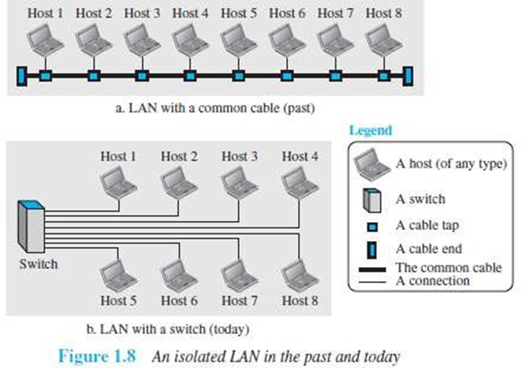
Network Models –
LAN – Local Area Network (Contd..)
Dr. A.I.T., C.S.E. Dr. Prerana Chaithra Computer Networks 21CST502 Unit 1

Slide 39
Network Models –
WAN – Wide Area Network
  A Wide-area Network (WAN) is a Computer Network that connects your offices, data centers, cloud applications, and cloud storage together.
  It spans beyond a single building or large campus to include multiple locations spread across a specific geographic area, or even the world.
It is used to connect computers anywhere in the world.
It can cover larger geographical area. It can cover cities, countries and even continents.
It interconnects connecting devices such as switches, routers, or modems.
Normally, WAN is
  created & run by communication companies (Ex: BSNL, Airtel)
  leased by an organization that uses it.
Dr. A.I.T., C.S.E. Dr. Prerana Chaithra Computer Networks 21CST502 Unit 1

Slide 40
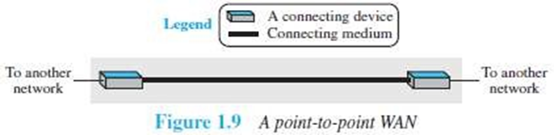
WAN – Wide Area Network
Point-to-Point WAN
  Point-to-Point WAN A point-to-point WAN is a network that connects 2 communicating devices through a transmission media
  Consists of a leased line that connects a computer or a small LAN to an ISP
  Generally used to provide internet access
  Example : Point to Point WAN – leased line from a Telephone
Dr. A.I.T., C.S.E. Dr. Prerana Chaithra Computer Networks 21CST502 Unit 1

Slide 41
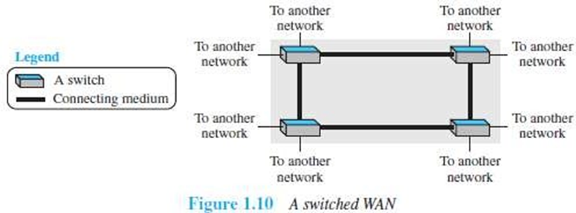
WAN – Wide Area Network
Switched WAN
  Switched WAN Connects the end systems which generally consists of a router that connects to another LAN or WAN.
  It is a network with more than two ends.
  It can be the backbones that connect the Internet.
  A switched WAN is a combination of several point-to-point WANs that are connected by switches
  Example : Switched WAN - Asynchronous Transfer Mode network
Dr. A.I.T., C.S.E. Dr. Prerana Chaithra Computer Networks 21CST502 Unit 1

Slide 42
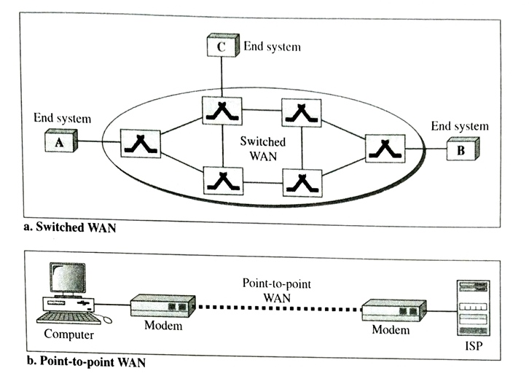
Network Models –
WAN – Wide Area Network
  Internetwork Connection of two or more networks
Dr. A.I.T., C.S.E. Dr. Prerana Chaithra Computer Networks 21CST502 Unit 1

Slide 43
Network Models –
MAN – Metropolitan Area Network
  A metropolitan area network (MAN) is a computer network that connects computers within a metropolitan area, which could be a single large city, multiple cities and towns, or any given large area with multiple buildings.
  Network size is between that of a LAN and WAN.
  Example : Cable TV network
Dr. A.I.T., C.S.E. Dr. Prerana Chaithra Computer Networks 21CST502 Unit 1

Slide 44
1.3 The Internet
internet is two or more networks that can communicate with each other.
Most notable internet is Internet
Internet is a collaboration of more than hundreds of thousands of interconnected networks.
Internet came to existence in 1960s.
In 1969 ARPANET came into existence
Dr. A.I.T., C.S.E. Dr. Prerana Chaithra Computer Networks 21CST502 Unit 1

Slide 45
The Internet Today
The Internet today is made up of many WANs and LANs joined by connecting devices and switching stations
Internet Service Provider - ISP- provides Internet to the end users
Different types of ISPSs
  International Internet Service Providers
  Connects nations together
  National Internet Service Providers
  Connects within the nation
  Regional Internet Service Providers
  are smaller ISPs connected to one or more national ISPs
  Local Internet Service Providers
  provide direct service to the end users
Dr. A.I.T., C.S.E. Dr. Prerana Chaithra Computer Networks 21CST502 Unit 1

Slide 46
The Internet Today (Contd..)
International Internet Service Providers
They connect nations together
They are at the top of the hierarchy
National Internet Service Providers
They are backbone networks created and maintained by specialized companies
There are connected by complex switching stations called Network Access Points (NAPs)
Some national ISP networks are also connected to one another by Private Switching stations called Peering Points
They operate at High data rate.
Regional Internet Service Providers
They connect nations together
Local Internet Service Providers
They connect nations together
  Connects nations together
  National Internet Service Providers
  Connects within the nation
  are smaller ISPs connected to one or more national ISPs
  Local Internet Service Providers
  provide direct service to the end users
Dr. A.I.T., C.S.E. Dr. Prerana Chaithra Computer Networks 21CST502 Unit 1

Slide 47
The Internet Today (Contd..)
Regional Internet Service Providers
They are smaller ISPs connected to one or more national ISPs
They operate at smaller data rate.
Local Internet Service Providers
They provide direct service to the end users
They are connected to regional ISPs or directly to the national ISPs
Most end users are connected to the local ISPs
Dr. A.I.T., C.S.E. Dr. Prerana Chaithra Computer Networks 21CST502 Unit 1

Slide 48
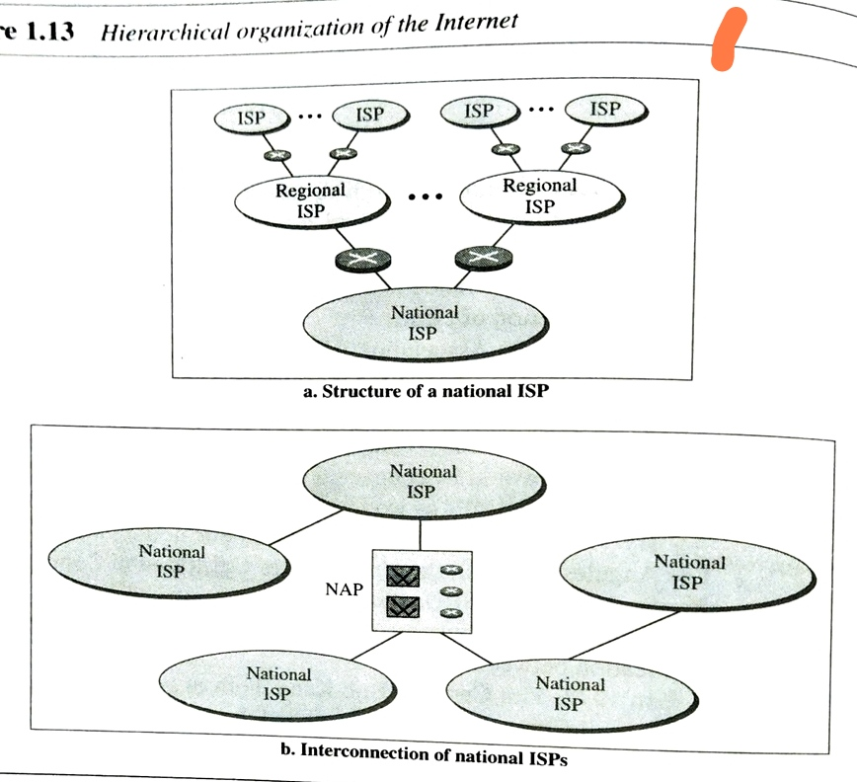
Internet Service Providers
Dr. A.I.T., C.S.E. Dr. Prerana Chaithra Computer Networks 21CST502 Unit 1

Slide 49
1.4 Protocols and Standards
Protocols
A Protocol is a set of rules that govern data communications.
  It defines
    What is communicated
    How it is communicated
    When it is communicated
    Key Elements of a Protocol
    Syntax : Structure or format of the data
    Example:1st 8 bits sender address, 2nd 8 bits receiver address remaining bits Message
    Semantics : Meaning of each section of bits
    Example : Address is route to be taken or final destination
    Timing : When data should be send and fast they can be sent
    Example : Sender sends data at 100 Mbps, Receiver can receive at 10 Mbps,
    Data will be lost due to overload
Dr. A.I.T., C.S.E. Dr. Prerana Chaithra Computer Networks 21CST502 Unit 1

Slide 50
1.4 Protocols and Standards
Standards
Standards
They provides guidelines to manufacturers, vendors, government agencies and other service providers to ensure the kind of interconnectivity necessary in today’s market place and in international communications.
2 categories of Data Communications Standards
    De facto standards
    De facto : (by fact or by convention)
    Structure or format of the data
    De jure standards
    De jure : (by law or by regulation)
    are standards that have been legislated by an officially recognized body.
Dr. A.I.T., C.S.E. Dr. Prerana Chaithra Computer Networks 21CST502 Unit 1

Slide 51
Standards Organizations
Standards are developed through the cooperation of
  Standards Creation Committee
  ISO : International Organization for Standardization
  ITU-T : International Telecommunication Union – Telecommunication
  Standards Sector
  CCITT : Consultative Community for International Telegraphy and Telephony
  ANSI : American National Standards Institute
  IEEE : Institute of Electrical and Electronics Engineers
  EIA : Electronic Industries Association
  Forums
  Regulatory Agencies
Dr. A.I.T., C.S.E. Dr. Prerana Chaithra Computer Networks 21CST502 Unit 1

Slide 52
Internet Standards
Internet Standard is a formalized regulation that must be followed by those who work with the internet.
A specification begins as an internet draft.
Internet Draft is a working document with o official status and a 6 month lifetime.
Request for Comment ( RPC ) upon recommendation from the internet authorities a draft may be published as a Request for Comment ( RPC )
Each RPC is edited, assigned a number and made available to all the interested parties.
Dr. A.I.T., C.S.E. Dr. Prerana Chaithra Computer Networks 21CST502 Unit 1

Slide 53
UNIT 1
CHAPTER 2
NETWORK LAYERS
Computer Networks 21CS502 Module 1
Dr. PRERANA CHAITHRA

Slide 54
Layered Tasks
Each layer uses the services of the layer immediately below it.
Layered model for Data communication and networking are
  OSI Model - Open Systems Interconnection Model
Standard for Data Communication
It was not fully implemented
  TCP/IP Protocol Suite (Transmission Control Protocol/Internetworking Protocol )
Dominant commercial architecture as it was used and tested extensively in the Internet
C.S.E., Dr. A.I.T., Dr. Prerana Chaithra Computer Networks 21CST502 Unit 1

Slide 55
OSI Model
Open Systems Interconnection Model
OSI is an ISO Standard that covers all aspects of network communications.
Introduction : in late 1970s
Model: OSI is a model and not a protocol.
Purpose : to show how to facilitate communication between different systems without requiring changes to the logic of the underlying hardware and software
Open System is a set of protocols that allows any two different systems to communicate regardless of their underlying architecture.
C.S.E., Dr. A.I.T., Dr. Prerana Chaithra Computer Networks 21CST502 Unit 1

Slide 56
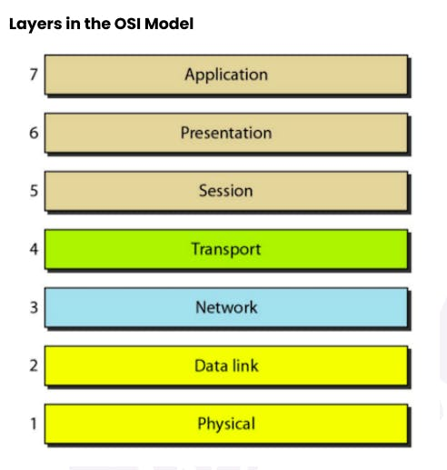
OSI Model Layers
C.S.E., Dr. A.I.T., Dr. Prerana Chaithra Computer Networks 21CST502 Unit 1

Slide 57
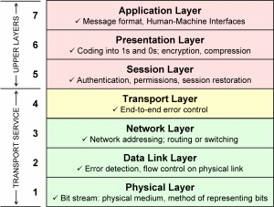
An exchange using the OSI model
C.S.E., Dr. A.I.T., Dr. Prerana Chaithra Computer Networks 21CST502 Unit 1

Slide 58
TCP/IP Protocol Suite
The TCP/IP protocol suite is made of five layers:
Physical Layer
Data link Layer
Network Layer
Transport Layer
Application Layer
The first four layers provide physical standards, network interfaces, internetworking, and transport functions that correspond to the first four layers of the OSI model.
The three topmost layers in the OSI model, however, are represented in TCP/IP by a single layer called the application layer
C.S.E., Dr. A.I.T., Dr. Prerana Chaithra Computer Networks 21CST502 Unit 1

Slide 59
TCP/IP Protocol Suite
Physical Layer & Data link Layer
  At the physical and data link layers, TCPI/IP does not define any specific protocol.
  It supports all the standard and proprietary protocols.
  A network in a TCP/IP internetwork can be a local-area network or a wide-area network.
C.S.E., Dr. A.I.T., Dr. Prerana Chaithra Computer Networks 21CST502 Unit 1

Slide 60
TCP/IP Protocol Suite
Network Layer
At the network layer (or, more accurately, the internetwork layer), TCP/IP supports the Internetworking Protocol (IP)
IP uses four supporting protocols:
  ARP - Address Resolution Protocol
  is used to associate a logical address with a physical address
  RARP - Reverse Address Resolution Protocol
  allows a host to discover its Internet address when it knows only its physical address
  ICMP - Internet Control Message Protocol
  ICMP sends query and error reporting messages
  IGMP - Internet Group Message Protocol
  is used to facilitate the simultaneous transmission of a message to a group of recipients
C.S.E., Dr. A.I.T., Dr. Prerana Chaithra Computer Networks 21CST502 Unit 1

Slide 61
TCP/IP Protocol Suite
Transport Layer
Transport layer has UDP and TCP protocols responsible for delivery of a message from a process (running program) to another process.
  UDP - User Datagram Protocol
  It is a process-to-process protocol
  It adds only port addresses, checksum error control, and length information to the data from the upper layer.
  TCP - Transmission Control Protocol
  provides full transport-layer services to applications.
  SCTP - Stream Control Transmission Protocol
  allows a host to discover its Internet address when it knows only its physical address
C.S.E., Dr. A.I.T., Dr. Prerana Chaithra Computer Networks 21CST502 Unit 1

Slide 62
TCP/IP Protocol Suite
Application Layer
The application layer is equivalent to the combined session, presentation, and application layers in the OSI model.
Many protocols are defined at this layer.
  HTTP - Hyper Text Transfer Protocol
  It is the underlying protocol for world wide web. It defines how hypermedia messages are formatted and transmitted.
  FTP - File Transfer Protocol
  It is a client-server based protocol for transfer of files between client and server over the network.
  Telnet - Terminal Network
  provides bi-directional text-oriented services for remote login to the hosts over the network
  SMTP - Simple Network Management Protocol
  It is for managing, monitoring the network and for organizing information about the
  networked devices.
  DNS - Domain Name System
    It maps the IP addresses into domain names (human readable names).
C.S.E., Dr. A.I.T., Dr. Prerana Chaithra Computer Networks 21CST502 Unit 1

Slide 63
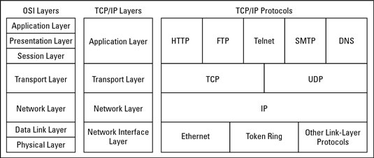
TCP/IP Protocol Suite
C.S.E., Dr. A.I.T., Dr. Prerana Chaithra Computer Networks 21CST502 Unit 1

Slide 64
UNIT 2
THE DATA LINK LAYER
Computer Networks 21CST502 Unit 2
Dr. PRERANA CHAITHRA

Slide 65
Introduction
Whenever bits flow from one point to another, they are subjected to unpredictable changes because of Interference.
Types of Errors
  Single-Bit Error
Only 1 bit in the data unit has changed
  Burst Error
2 or more bits in the data unit have changed
Redundancy
  To detect or correct errors, we need to send extra (redundant) bits with data.
C.S.E., Dr. A.I.T., Dr. Prerana Chaithra Computer Networks 21CST502 Unit 2

Slide 66
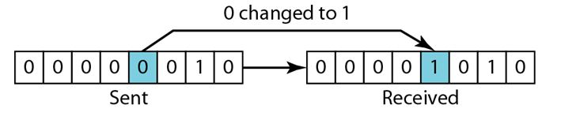
Single-Bit Error
Single-bit error means that only 1 bit of a given data unit (such as a byte, character, or packet) is changed from 1 to 0 or from 0 to 1.
Least likely to occur
C.S.E., Dr. A.I.T., Dr. Prerana Chaithra Computer Networks 21CST502 Unit 1

Slide 67
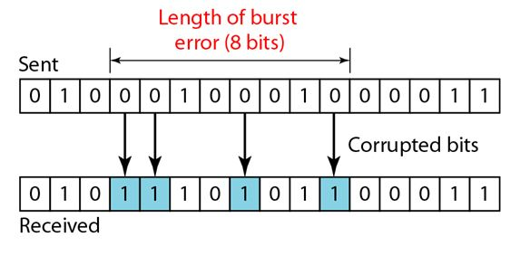
Burst Error
Burst error means that 2 or more bits in the data unit have changed from 1 to 0 or from 0 to 1.
A burst error is more likely to occur than a single-bit error
C.S.E., Dr. A.I.T., Dr. Prerana Chaithra Computer Networks 21CST502 Unit 1

Slide 68
Redundancy
To detect or correct errors, we need to send extra (redundant) bits with data.
These redundant bits are added by the sender and removed by the receiver.
Their presence allows the receiver to detect or correct corrupted bits.
C.S.E., Dr. A.I.T., Dr. Prerana Chaithra Computer Networks 21CST502 Unit 1

Slide 69
Detection Versus Correction
Detection
Error Detection we are looking only to see if any error has occurred.
The answer is a simple yes or no.
C.S.E., Dr. A.I.T., Dr. Prerana Chaithra Computer Networks 21CST502 Unit 1

Slide 70
Detection Versus Correction
Correction
Error Correction we need to know the exact number of bits that are corrupted and their location in the message.
The correction of errors is more difficult than the detection.
C.S.E., Dr. A.I.T., Dr. Prerana Chaithra Computer Networks 21CST502 Unit 1

Slide 71
THANK YOU
Dr. Prerana Chaithra

